Slide 1


NFL Dataset
Jake Willms, Mike Messina, Andrew Schiek, Dennis Kim

Slide 2
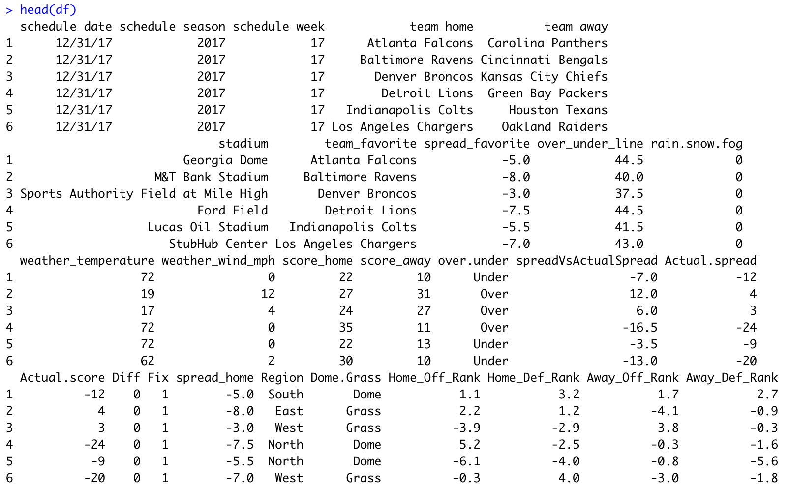
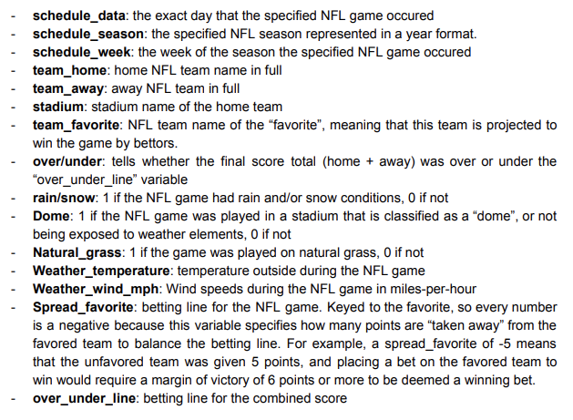
Overview of the Data
Every Regular Season NFL game from 2000 - 2017
4,592 observations
25 variables
10 factors
15 numeric

Slide 3
Data Preprocessing
A few data preprocessing steps were taken before analysis
Concerns over “spread_favorite” - problematic being in terms of the favorite, not home team
Spread_favorite is a negative variable that describes how many points the favorite team was “given” by betters.
Example: -7 would mean that a bet placed on the favorite would only win if the favorite won by 8 points or more.
Typically spread lines are +/- depending on how many points the home team is favored/unfavored by
This required some math and data transformations to create our new variable, “spread_home”
New variables, such as variables that represent the quality of a team’s offense and defense, were added throughout the project to add increased depth to our analysis and to improve our predictive capabilities.

Slide 4
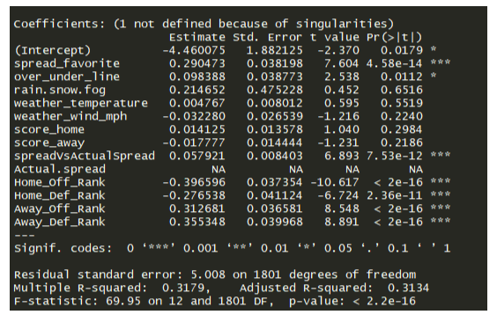
Baseline OLS Model
Standard LM() function in R
Used as our “base case” analysis to compute a simple linear regression
Results were extremely disappointing, poor predictability and model fit
Adjusted R-square of 0.3134
Many variables above p value of 0.05

Slide 5
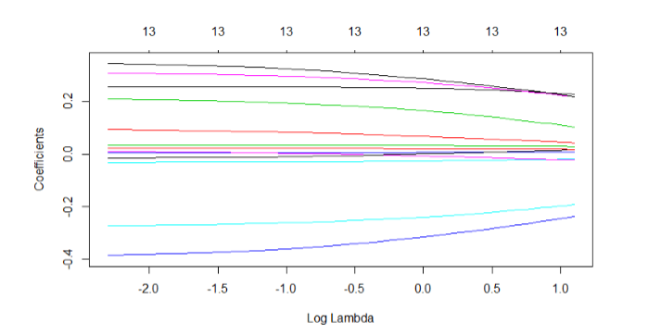
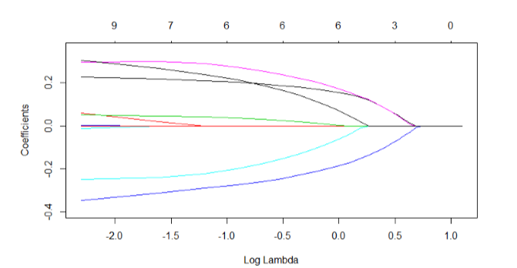
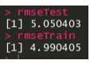
Ridge & Lasso: Test/Train Split
Explored the potential for overfitting and inconsistencies between Test/Train sets by computing Ridge and Lasso regression tests
Predicted via train set and compared to test set
Prediction was extremely close to actual
Split the data 80/20
Plots of Ridge/Lasso show distinct differences

Slide 6
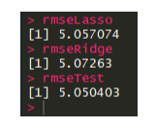
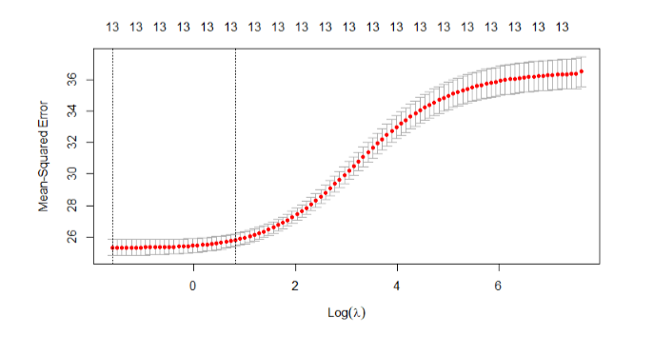
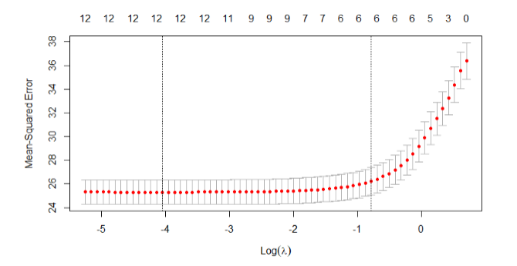
Ridge & Lasso: Results & Future Applications

Slide 7
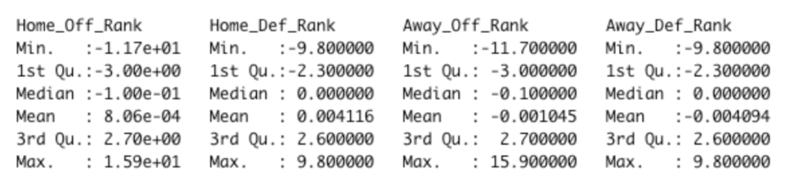
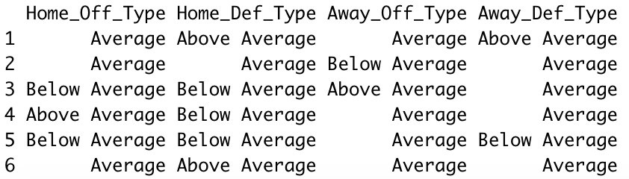
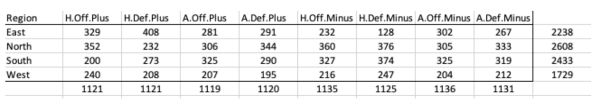
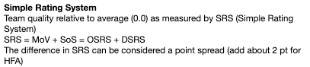
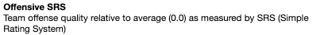
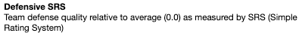
Correspondence Analysis
Relational technique used to attempt to summarize and interpret categorical variables of interest.
Team Offense and Defense Rank (OSRS and DSRS) were engineered into multi dimensional categorical variables
Above average, average, below average
We must pivot the dimensions of the two variables (team ranks and regions) to produce a table to run CA on
Per pro-football-reference.com

Slide 8
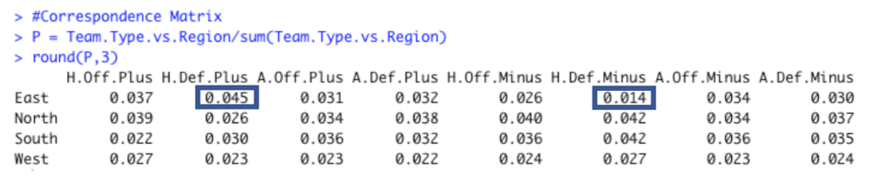
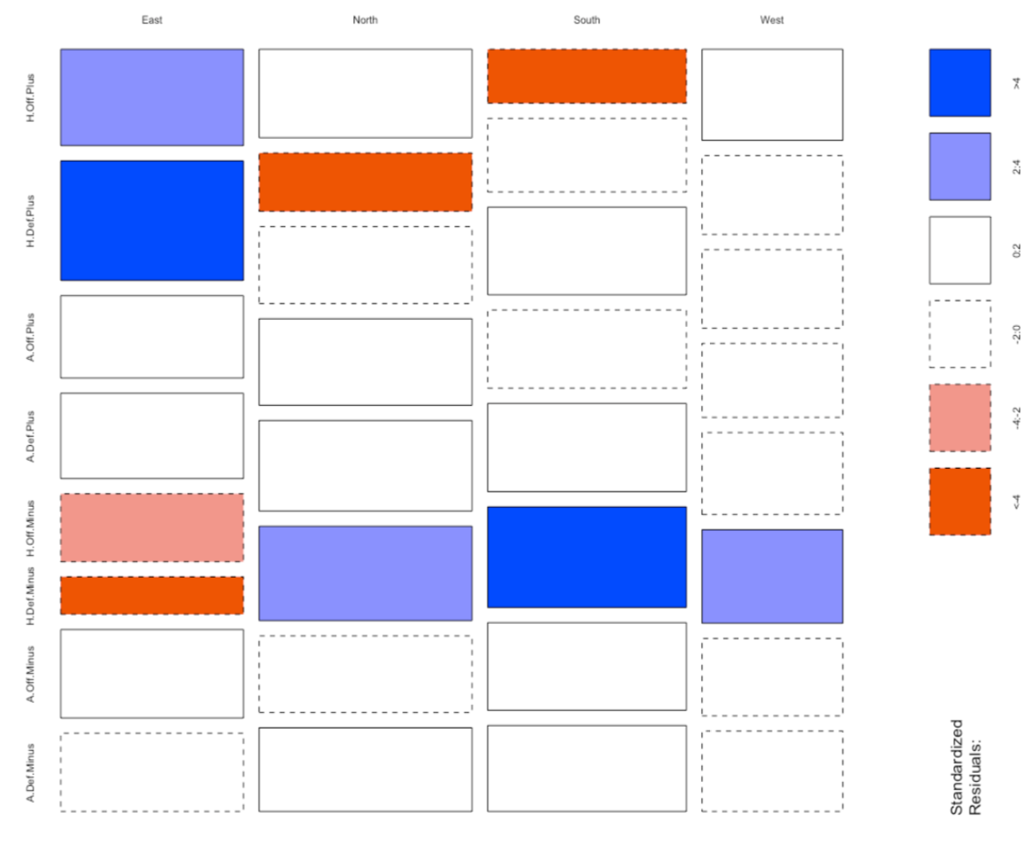
Team Type vs. Region
Correspondence Matrix
Highest correlation seen at 4.5%
Lowest correlation seen at 1.4%
Mosaic Plot
East region played host to home teams with above average offenses and defenses more often than expected.
East region also played host to home teams with below average defenses less often than average.
South region shows opposite results from the East region.

Slide 9
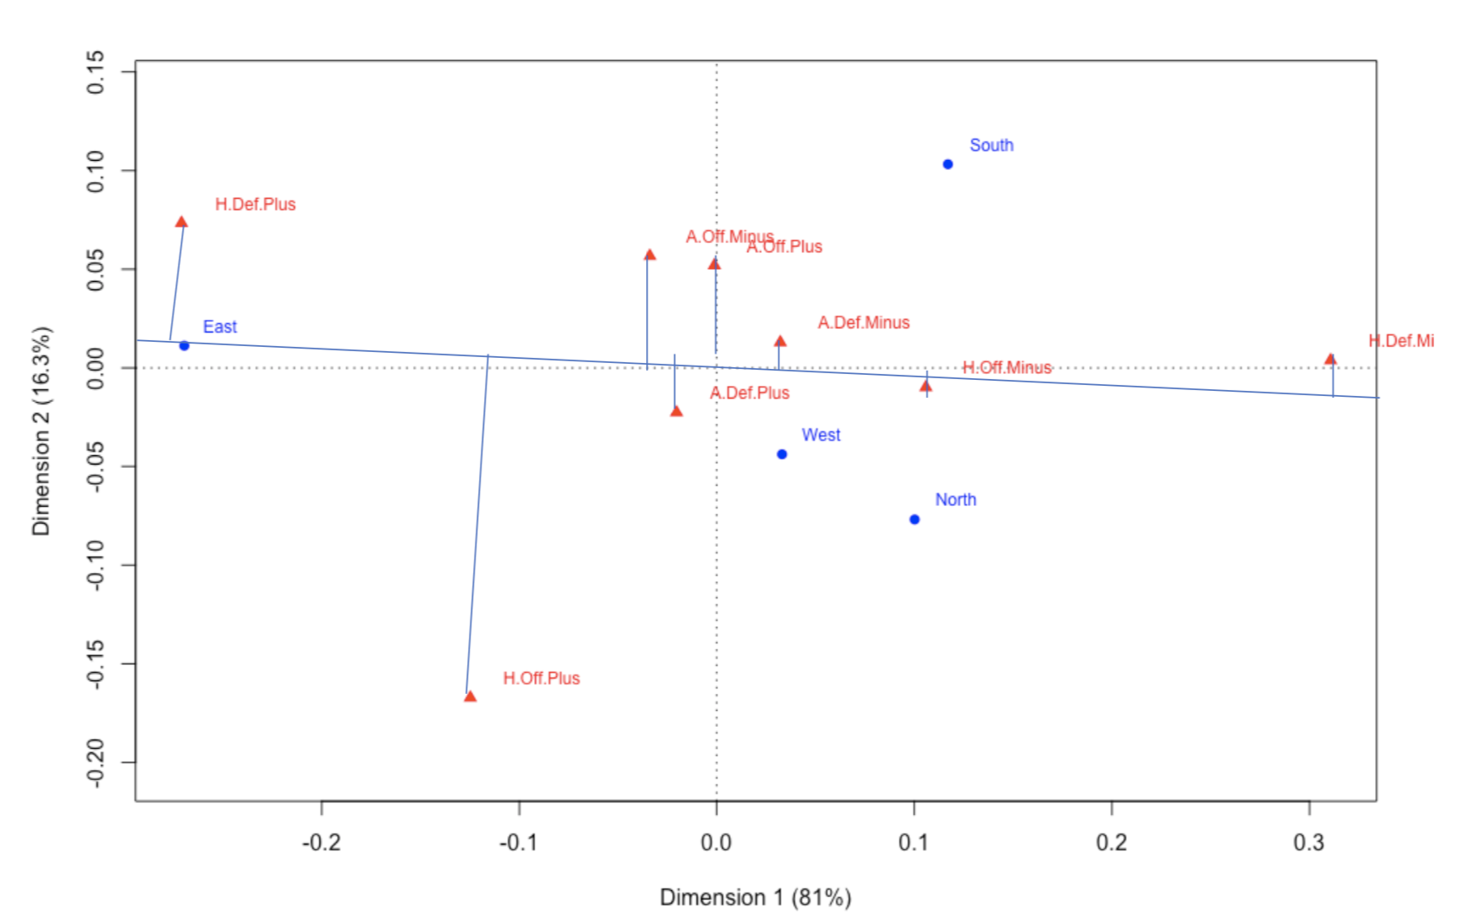
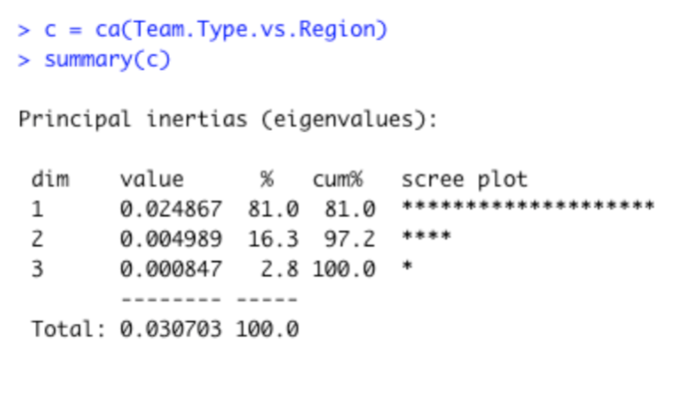
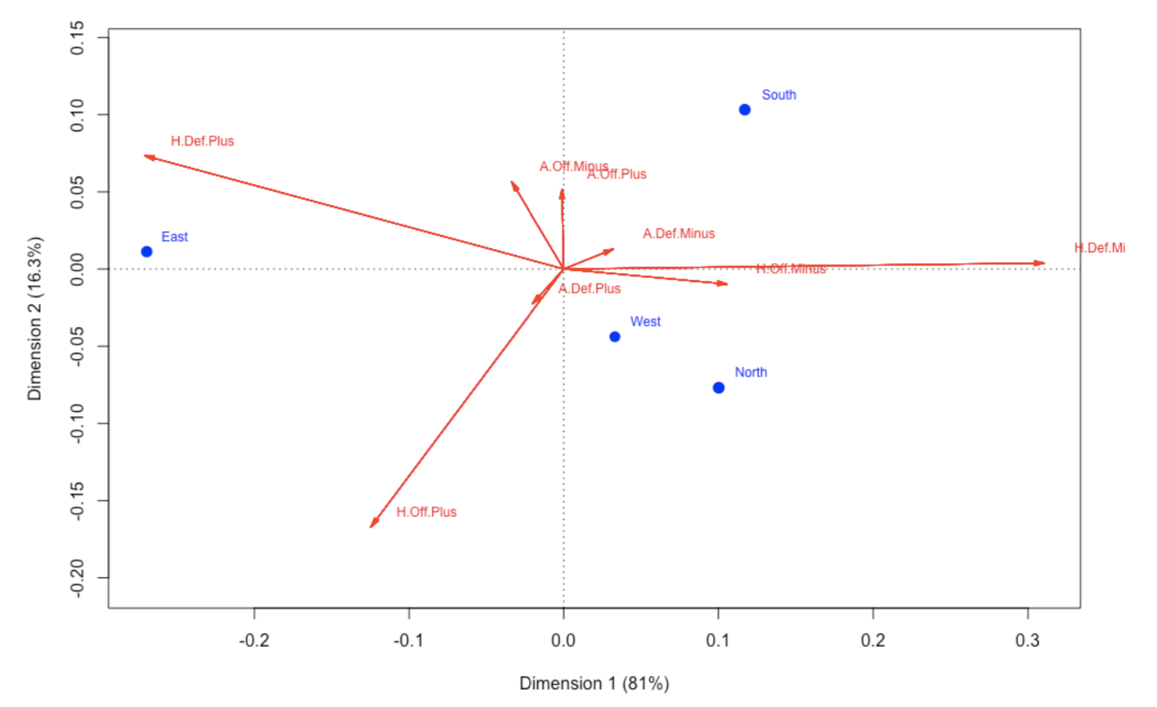
Correspondence Output
One dimension accounts for 81% of of the total variation
Symmetric Plot
Scale for which team types correspond to the East Region.
Team types closer to the East glyph on the line through the origin correspond more heavily.
Another Visualization
Obtuse angles from the origin correspond less. Acute angles from the origin correspond more likely on average.
Takeaways
Better understanding of how geographic location of an NFL game is related to offensive and defensive team types.
Relative relationships between multi dimensional categorical variables in the data

Slide 10
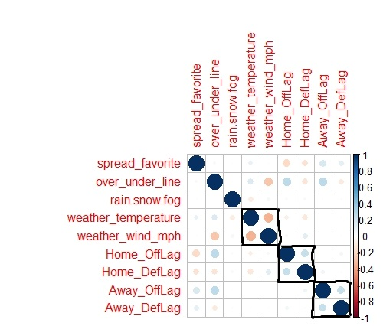
Exploring Dimensionality Reduction
After feature engineering, our dataset expanded to 25 variables, making any regression model verbose. And although we had a great number of observations over our measurement period, converting our nominal variables to dummy variables brought concerns of overcoming the curse of dimensionality.
Thus, PCA was employed to potentially reduce our dimensions down to more manageable factors underlying the data.
Unfortunately, our data had very little multicollinearity.

Slide 11
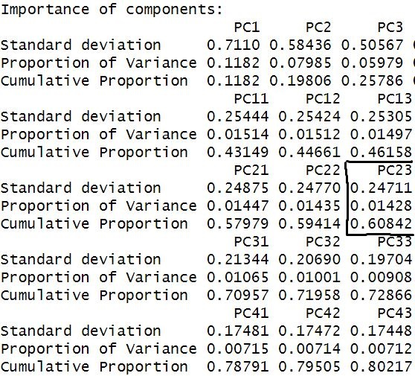
PCA Results
Minimal variance explained from component to component.
Twenty-three components required to reach 60% minimum threshold for predictive ends.
Model is not making it easier as it has only shrunk dimensions by a handful of variables.
Finally, factor interpretation is difficult. Regardless of factors used, factor analysis yields overlapping components until issues of overfitting take. There was no in-between (e.g., there were no instances where only one or two variables were correlated to factors).

Slide 12
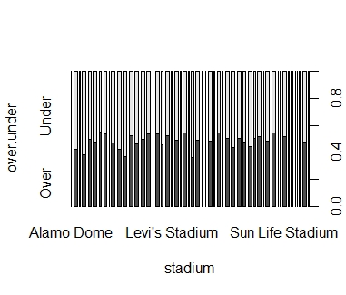
Addressing Stadium Conundrum
Thirty-two teams and separate stadiums make for a lot of dummy variables.
This added an incredible amount of factor issues.
This drove our PCA to calculate 135 components.
Bar chart indicates no stadium with an overwhelming effect on over/under outcomes.

Slide 13
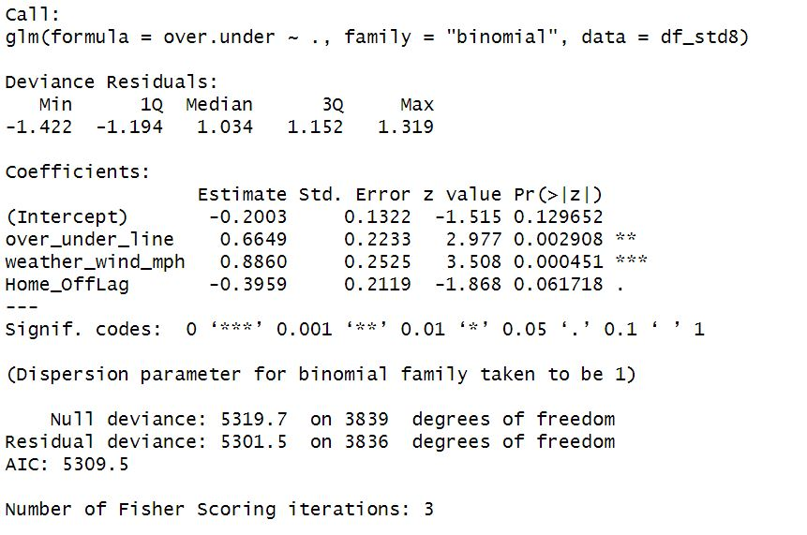
Predicting Over/Under
Logistic model deployed
Stepwise model building
Three significantly non-zero variables at ⍺ = 10%:
Over under line, ex-ante
Wind conditions
The quality of the home team’s offense
Interesting notes:
Wind and temperature conditions were correlated, meaning we’ve avoided multicollinearity without losing the missing variable’s apparent influence.
Quality of home offense is just over 5% alpha threshold.

Slide 14
Classification Quality
Insight:
Overall, our model correctly classified over half of the games it saw and performed similarly on data it had yet to see; however, while our model could accurately classify either instance, it was far superior in recalling instances where the game score did not exceed its winning threshold.
 | Predicted Over | Predicted Under | Total
Actual Over | 438 | 852 | 1290
Actual Under | 390 | 1008 | 1398
Total | 828 | 1860 | 2688
Pos recall = 34%
Neg recall = 72%
Pos precision = 53%
Neg precision = 54%
Overall train accuracy = 53%
Overall test accuracy = 52%

Slide 15
Potential Applications
Potential Application:
Take the model accuracy at face value.
Bet in small doses so that you can make many bets (divided equally between outcomes) and avoid any one bet being your demise.
or -
Bet more often on games with a predicted score outcome below the line.
The model is just as accurate for “under” outcomes as it is “over” outcomes, but the model makes fewer false negative errors.
Again, bet reasonably.
Notes for application and extension:
Considering the betting fee (vig), a 53% accuracy clip guarantees profit. Our model is right at that threshold.
By sticking to bets for games under the line, a bettor should profit handsomely, in theory.

Slide 16
Preprocessing for LDA
Split into 3 groups: team factors, combinations of teams and weather, best overall accuracy
Team factors: Over/Under Line, Actual Score, Spread (home), Home Offensive Rank, Home Defensive Rank
Combination: Over/Under Line, Rain/Snow/Fog, Temperature, Wind Speed, Actual Score
Best: Over/Under Line, Temperature, Wind Speed, Actual Score, Spread (home), Home Offensive Rank, Home Defensive Rank
Note that the original data set had a mountain region but this was combined with the West region as the original models couldn’t differentiate the two
Code for generating subsets:
FootballSubset <- DSC.424.Proj.w.Ranks[c(9,18,21,24,25,22)]
FootballSubset <- DSC.424.Proj.w.Ranks[c(9,10,11,12,18,22)]
FootballSubset <- DSC.424.Proj.w.Ranks[c(9,11,12,18,21,24,25,22)]

Slide 17
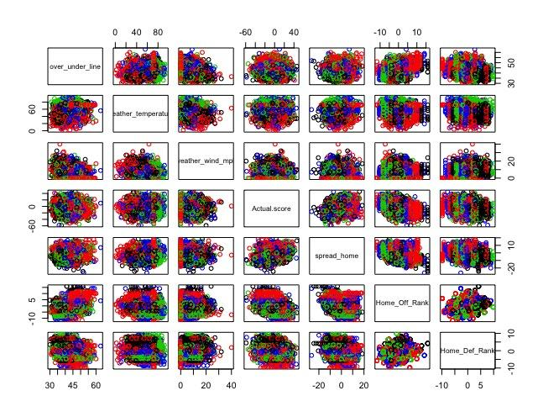
Correlation Plots
Shown on the right are the plots for the best model subset
Plots were generated for each model
All did not show a strong separation based on region

Slide 18
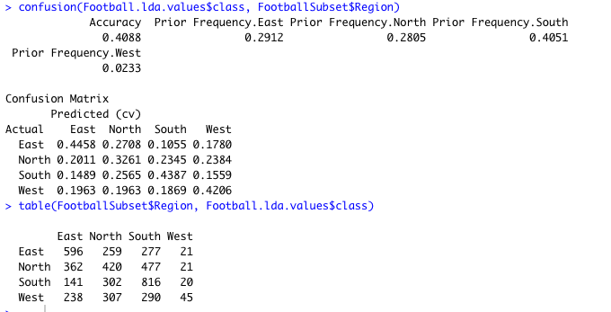
Fitting the Model
I fit each of the models with LDA and displayed the confusion matrix for the best model on the right
Originally with the Mountain region the model was unable to separate this so it was removed and combine with the West region
Even with this combination the model is still poor at predicting the West region, but now the lowest accuracy is with the North region
The accuracy for the best model was ~41%

